Slide 1
Cell Membrane
It is the outer covering of each cell .
A thin, delicate and semi permeable membrane.
^{Function}
Allow entry and exits of selective material.
Protects against bacteria.
Maintain the shape.

Slide 2
Composition of plasma membrane
Lipids | Protein | Carbohydrates/sugars
Phospholipid | Fibrous, globular, structural proteins etc. | Oligosaccharides,hexose Fucose sugars etc.
Cholesterol | Types~ Intrinsic & Extrinsic proteins. | Types~ Glycoprotein &Glycolipids.
Lipids
Lipids
Lipids
Lipids
Lipids
Lipids
Protein

Slide 3
Models of the cell membrane
A number of models were proposed in order to explain the dynamic structure of the plasma membrane. Some of the prominent ones include:
Lipid and Lipid Bilayer Model (1925-26)
Dannelli Model (1935)
Robertson’s unit Membrane Model (Protein-Lipid Bilayer-Protein) (1953)
Fluid Mosaic Model (1972)

Slide 4
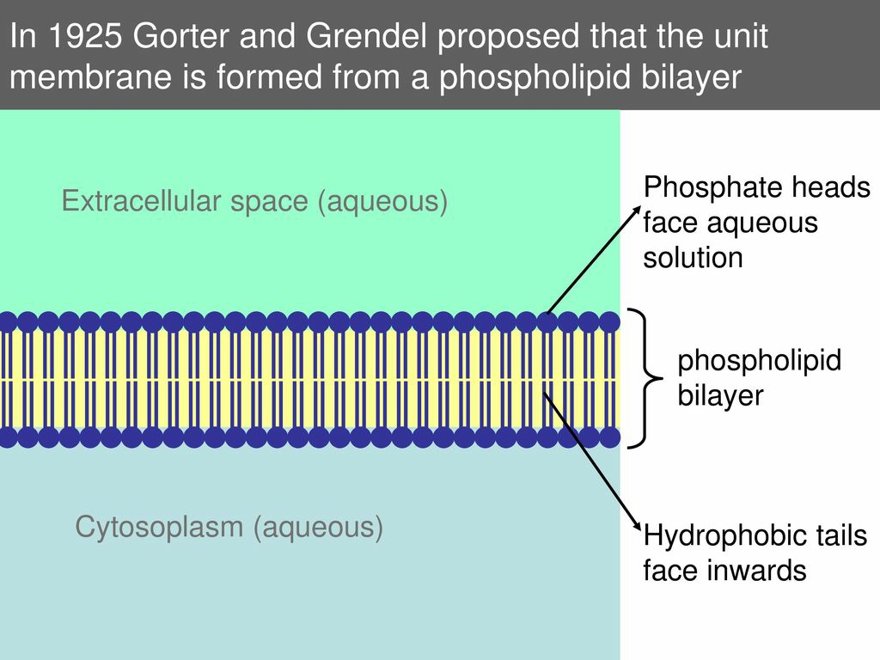
Gorter and Grendel (1925):
Based upon the experiments with erythrocytes.
Observed that lipid extracted from the RBC’s got spread in area twice that of a simple molecular film.
Lipid makes a bilayer in the membrane with the polar hydrophilic groups.

Slide 5
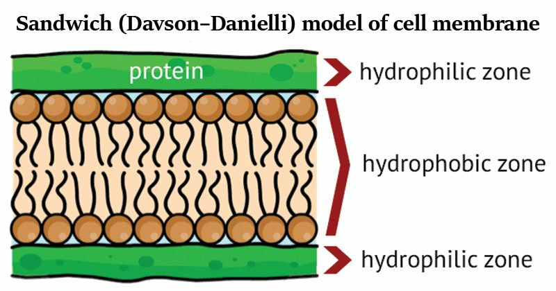
Dannelli and Davson Model(Sandwich Model):
James Dannelli and Hugh Davson in 1935 suggested a bimolecular laminar or leaflet model of the cell membrane.
The model describes the biological and chemical properties of the membrane.
It describes a phospholipid bilayer that lies between two layers of globular proteins and it is a trilaminar and lipoproteinous.
First model that attempted to describe the position of proteins within the lipid bilayer found in membranes.
Dannelli and Davson proposed a model whereby two layers of protein flanked a central phospholipid bilayer.
The model was also described as a ‘lipo-protein sandwich’, as the lipid layer was sandwiched between two protein layers.

Slide 6
Robertson model
J David Robertson modified Danielli and Davson Model.
He said that lipid bilayer is covered on two surface by B- protein molecules.
He gave the concept of unit membrane.
Proteins are B- fibrous.
Thickness of plasma membrane is 75-100A’
Plasma membrane is amphipathic.

Slide 7
Fluid mosaic model
Given by Singer and Nicolson in 1972.
This model consist of phospholipids, cholesterol, proteins,and carbohydrates.
The membrane also describe as “ Protein iceberg in a sea of phospholipids”.
Plasma membrane is lipoproteineous and trilaminar.
Plasma membrane is quasi-fluid.
Phospholipid molecules shows two types of movement---
Transition movement
Flip-flop movement.

Slide 8
